Slide 1
What can data science do for the study of religion? A comparison of classification methods
Simon Brauer, Ph.D.
simon.brauer@duke.edu
www.simonbrauer.us

Slide 2
Goals
Clarify: What is data science? Why should we care about it? And why might we be hesitant?
Assess “new” methods
Rule finders
Support Vector Machines (SVM)
Discuss opportunities and challenges to using these methods in the study of religion

Slide 3
What is data science?
David Donoho (“50 years of Data Science”) “Clearly, there are many visions of Data Science and its relation to Statistics.”
My usage
An emphasis on prediction over inference (at least compared to sociologists)…
…which leads to an emphasis on algorithms over probability models

Slide 4
Why should we care? And why should we be hesitant?
Many examples of exceptional performance
Many methods have intuitive interpretations
However
Social life is messy
Far fewer predictors available in surveys compared to big data problems
Sociologists care about the meaning of the variables we use, not just model performance
Notes:
Casella, Fienberge, and Olkin (2006): logistic regression preferred over SVM when classes overlap a lot
Thus: balance prediction with usefulness

Slide 5
Test case in the sociology of religion: The born-again
Evangelicalism and the born again
Christian Smith (1998): evangelicals are far more diverse than we generally recognize (though boundaries certainly exist)
Andrew Greeley and Michael Hout (2006): Conservative Protestants (2/3 are evangelical) are most well-categorized by their orientation toward the Bible
Jeremy Thomas and Daniel Olson (2012): evangelical elites changing their moral reasoning on homosexuality

Slide 6
Methods

Slide 7
Data
General Social Survey
1991, 1998, 2008, 2018
Listwise deletion
N = 3,139/8,720
Applied weights to equally weight each class
$$w_{c}=\frac{n}{n_{c}}$$

Slide 8
Variables
Outcomes
Born-again / Not born-again
Predictors
Age
Male/Female
Years of education
Frequency of religious service attendance [0-8]
Frequency of prayer [0-5]
Strength of belief in God [0-5]
Belief in the Bible’s inspiration/literalism [0-4]
Political ideology [0-6]
Abortion acceptable in cases of rape [0-1]
How wrong is homosexual relationship [0-3]
Notes:
Cutoffs: Not spiritual/religious at all + Slightly spiritual VS Moderately spiritual + Very spiritual/religious

Slide 9
Classification methods
“Familiar” methods: Generalized linear models
(Binary or multinomial) Logistic/probit regression
“Data science” methods
Rule finders
Support vector machines
Classification trees*
K-means clustering*
Nearest neighbor classifiers*
Neural networks*
*Not discussed here

Slide 10
Logistic regression
The Process
Iterate over a likelihood function to estimate class probability given linear predictors in a logit transformation
$$Y_{i}\sim Bernoulli\left(logit^{−1}\left(α+βX_{i}\right)\right)$$
The Results
Probability model of the outcome
Predict$Y=0 if α+βX<0$
$Y=1 if α+βX>0$

Slide 11
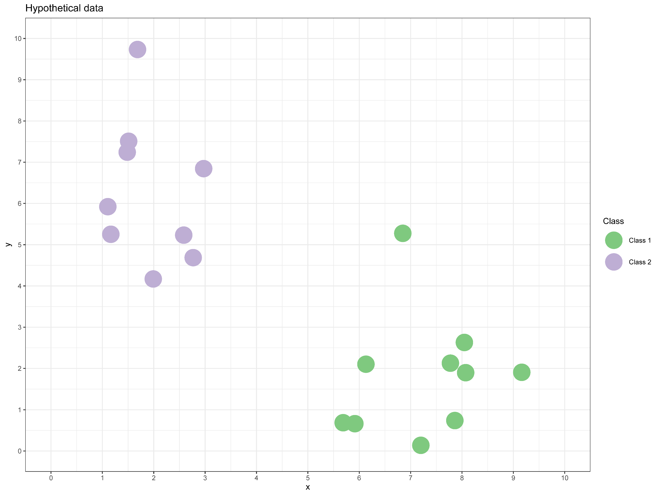

Slide 13
Rule finders
The Process
Divide the data according to the outcome variable
Create complex rules that do the best job possible at defining each class
Prune the rule sets to maximize prediction while not being too complex
The Result
A list of human-readable rules for dividing the data

Slide 14
Rule 1
If X < 4 and Y > 3.5, classify as Class 2
Rule 2
If X > 5 and Y < 6, classify as Class 1

Slide 15
Rule 1
If X < 4 and Y > 3.5, classify as Class 2
Rule 3
If X < 7.5 and Y > 3.25, classify as Class 1
Rule 4
Otherwise, classify as Class 2
Rule 2
If X > 5 and Y < 3 classify as Class 1

Slide 16
Support Vector Machines (SVMs)
The Process
Define a transform function (“kernel”) to improve separation
Define the cost of mis-classification
Draw a hyperplane that perfectly segments the data according to class
The Result
A multi-dimensional boundary line/plane/hyperplane used to predict class membership

Slide 18
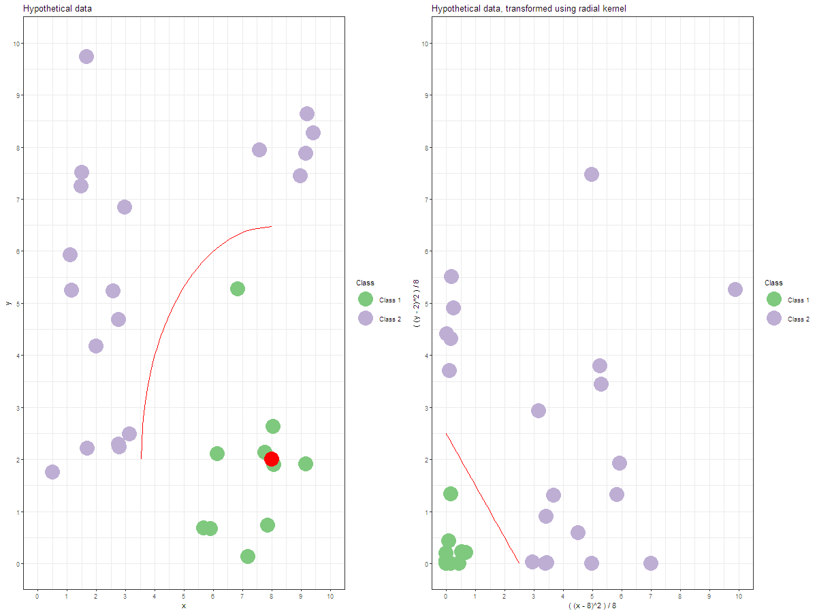
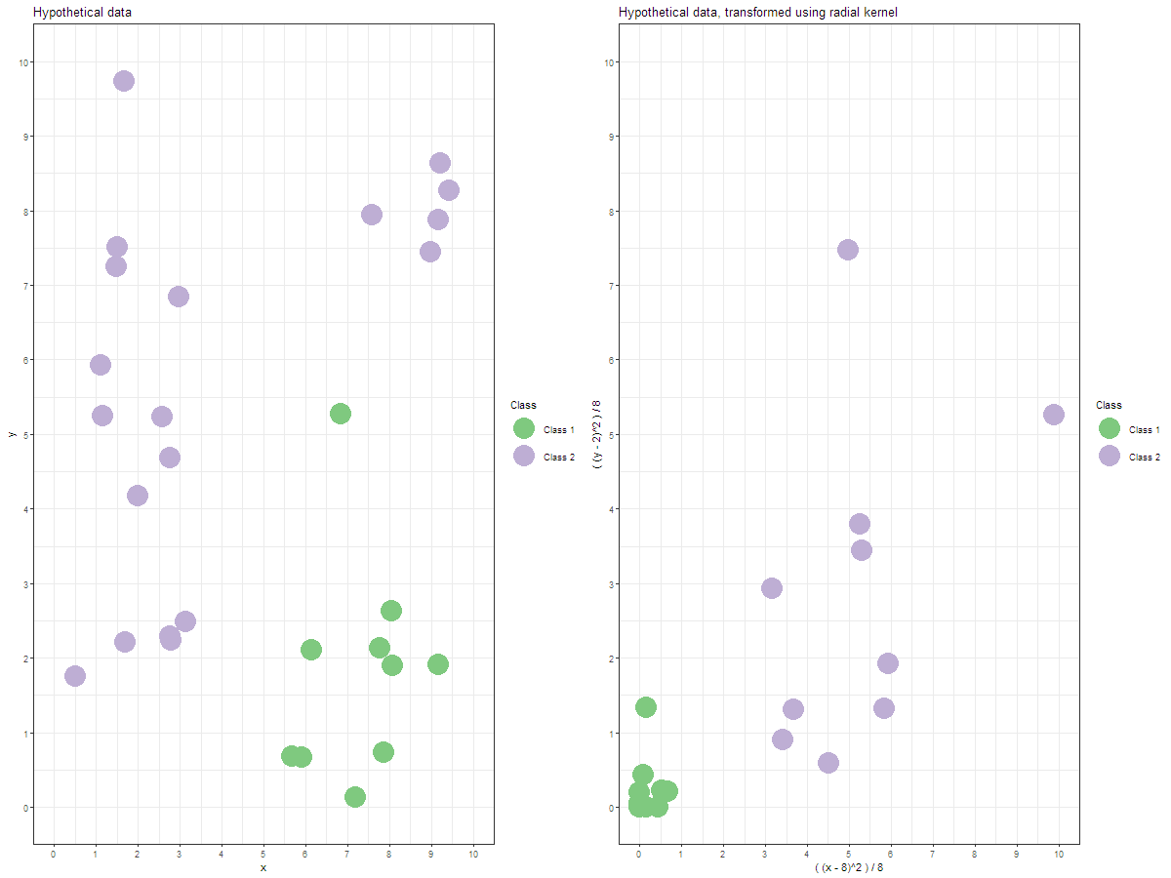
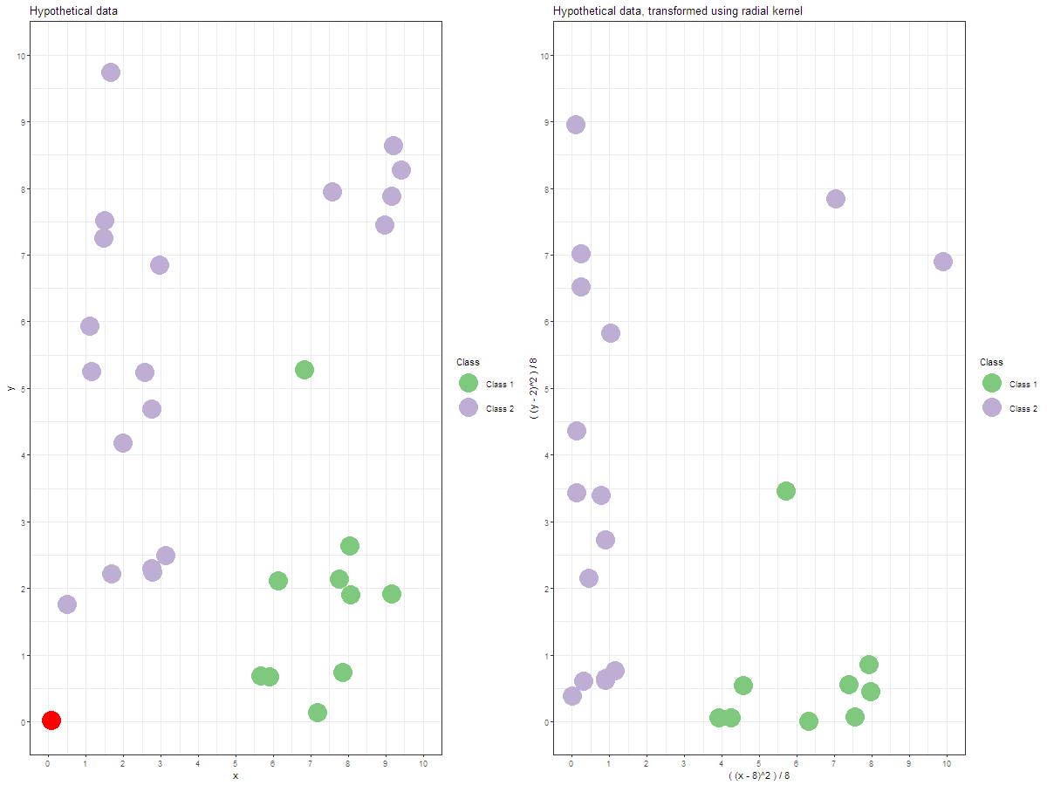

Slide 19
Measure of success
Baseline predictive accuracy (Null model)
Predict the largest group across the entire dataset
Optimal predictive accuracy (Saturated model)
Predict the largest group in each cell
Model predictive accuracy
Test predictive accuracy using 10-fold cross-validation

Slide 20
Results

Slide 21
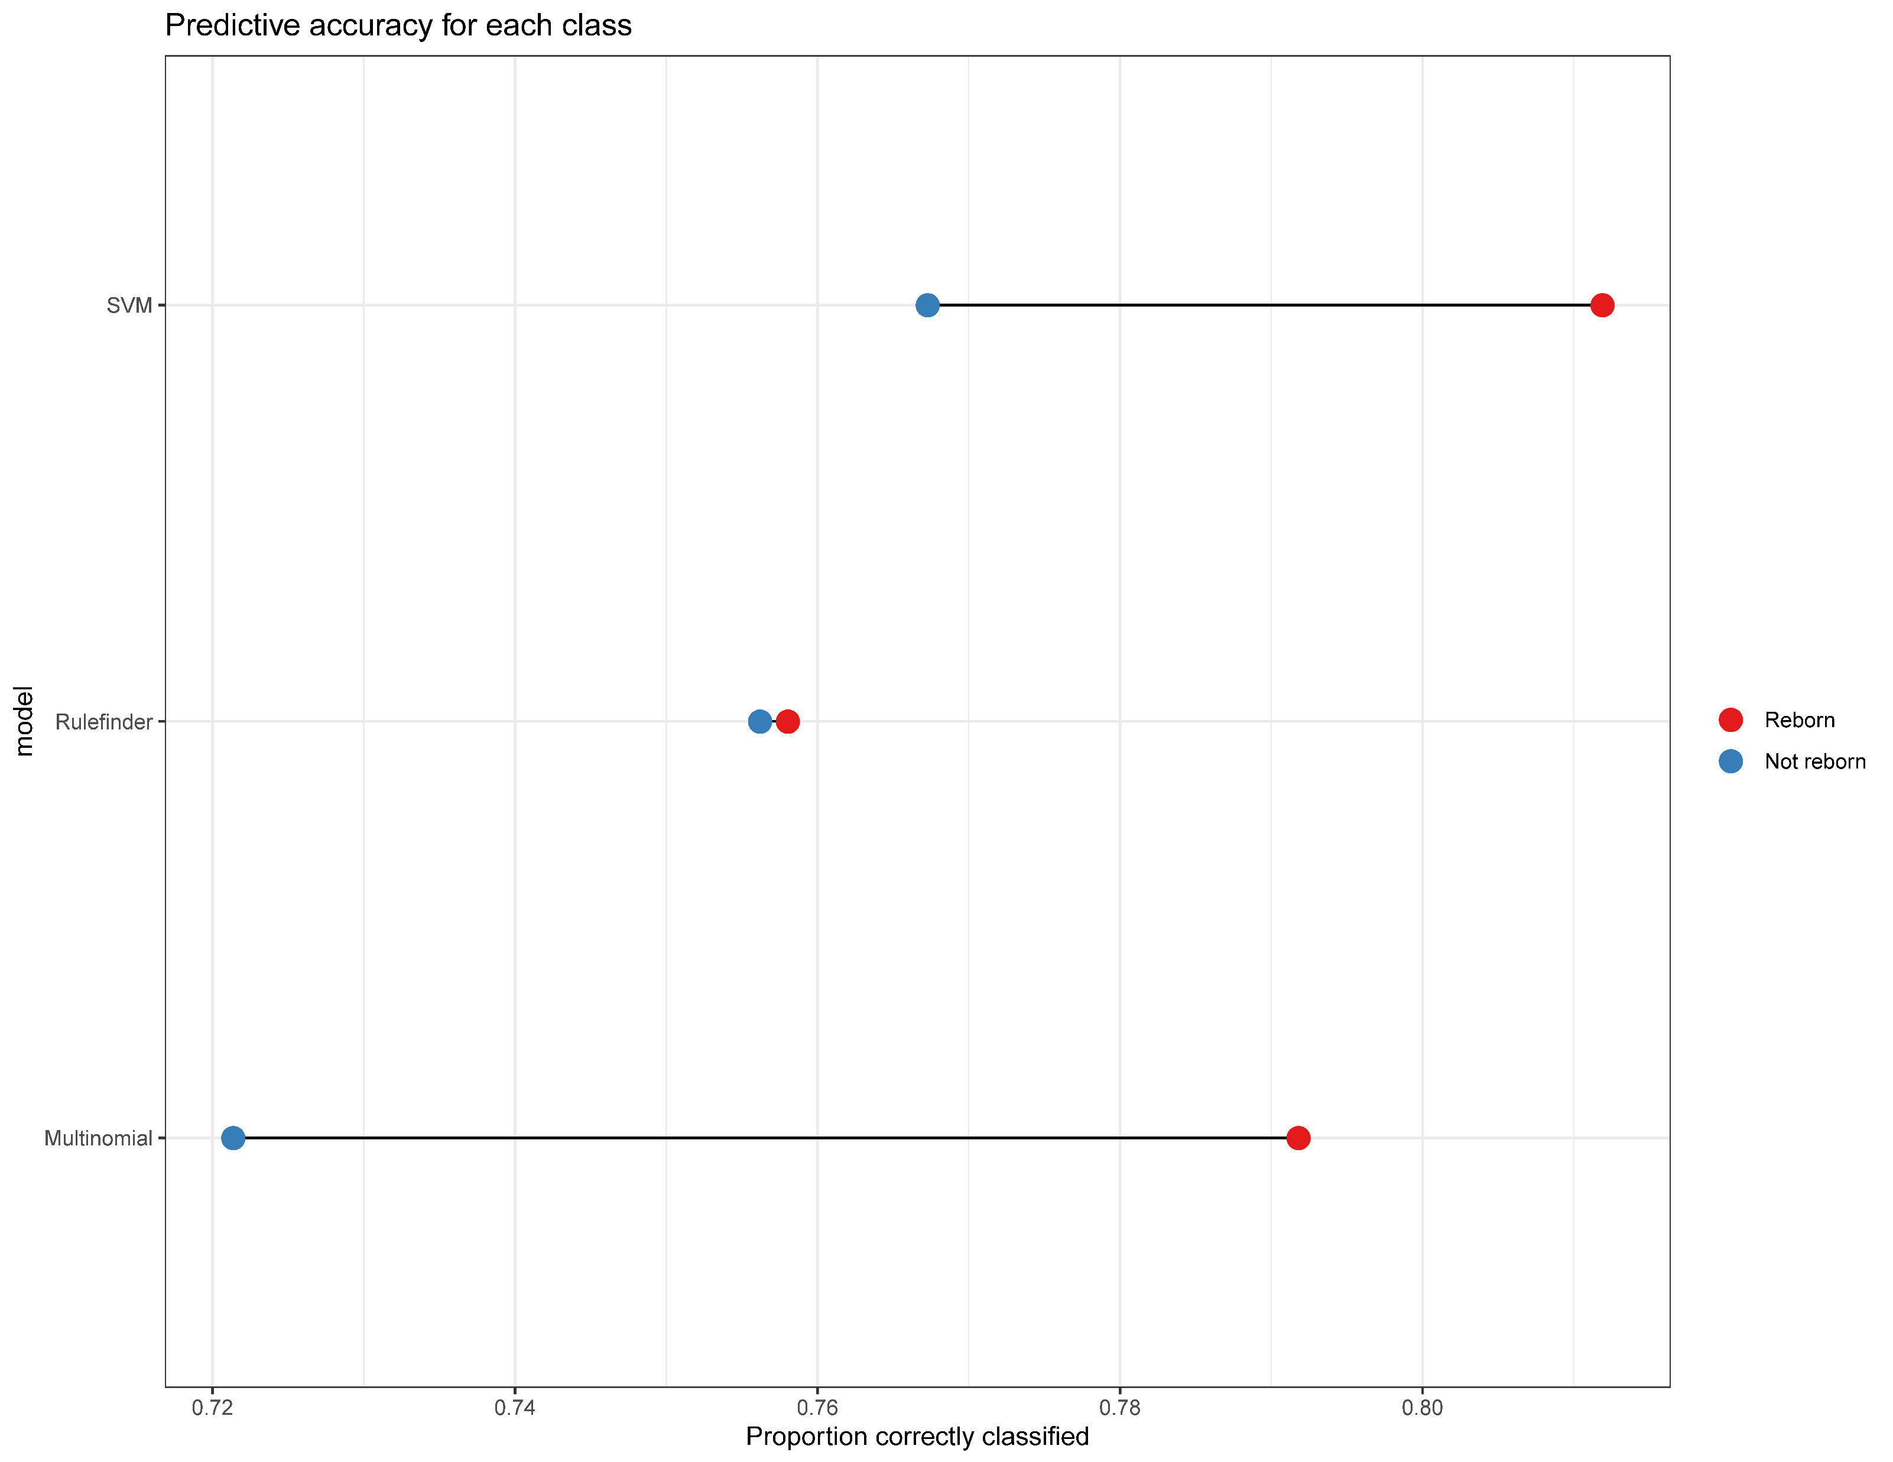
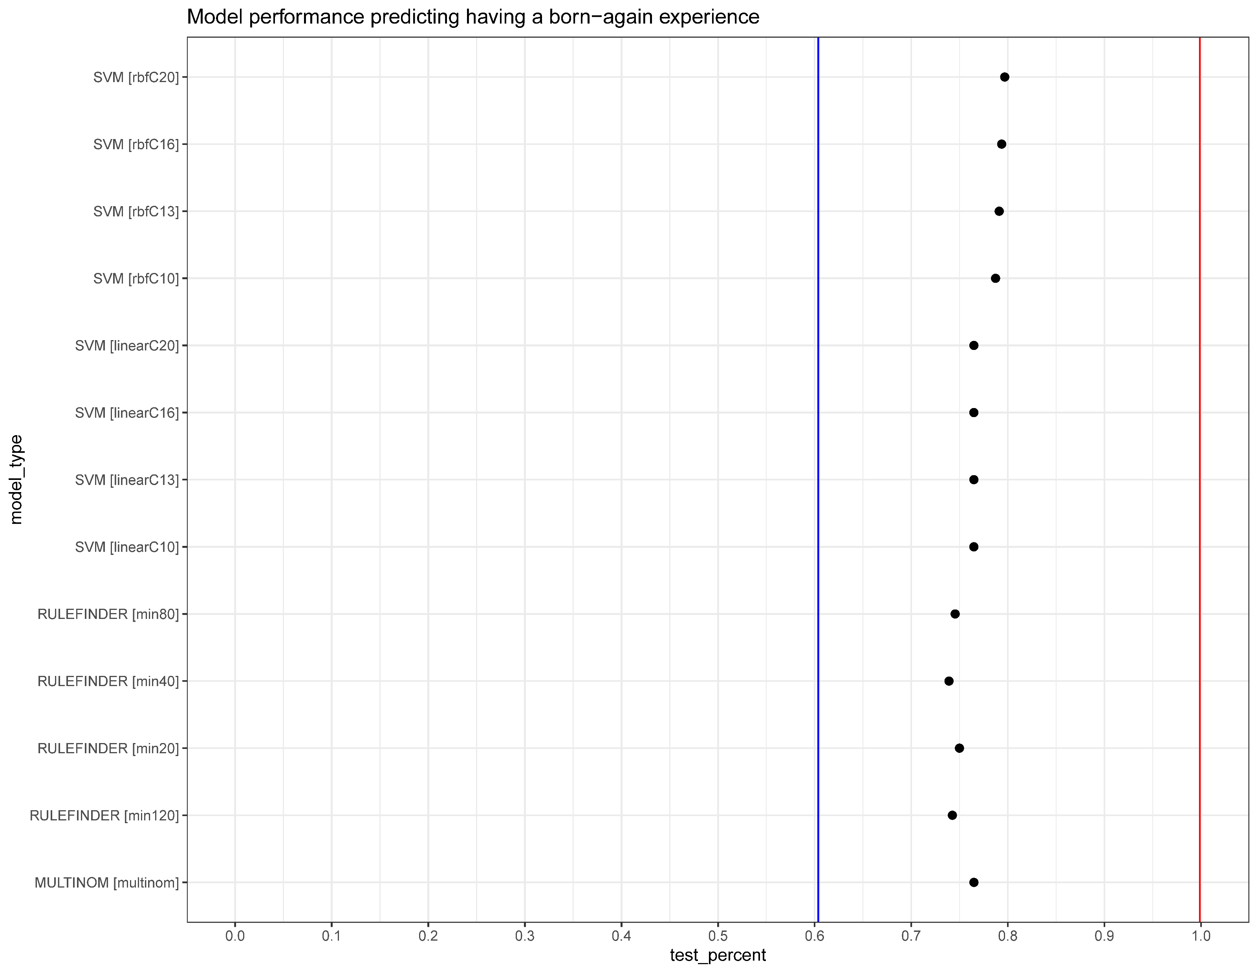
Born-again experience
…

Slide 22
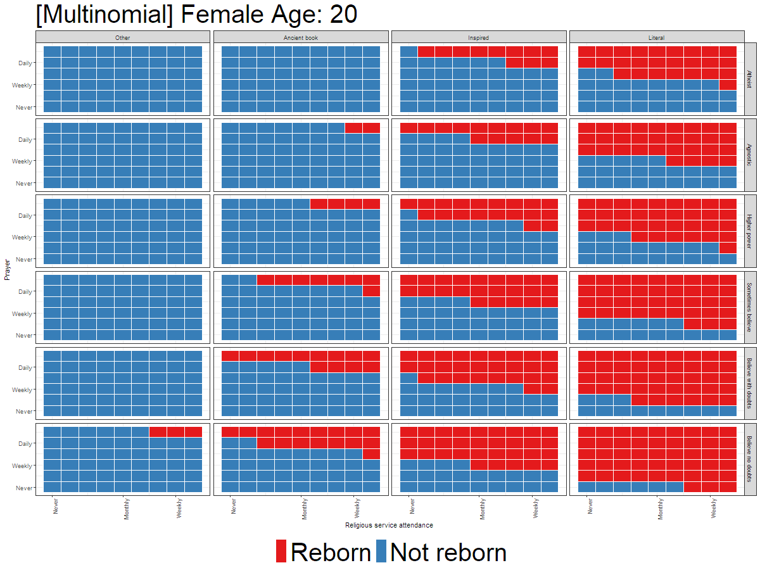
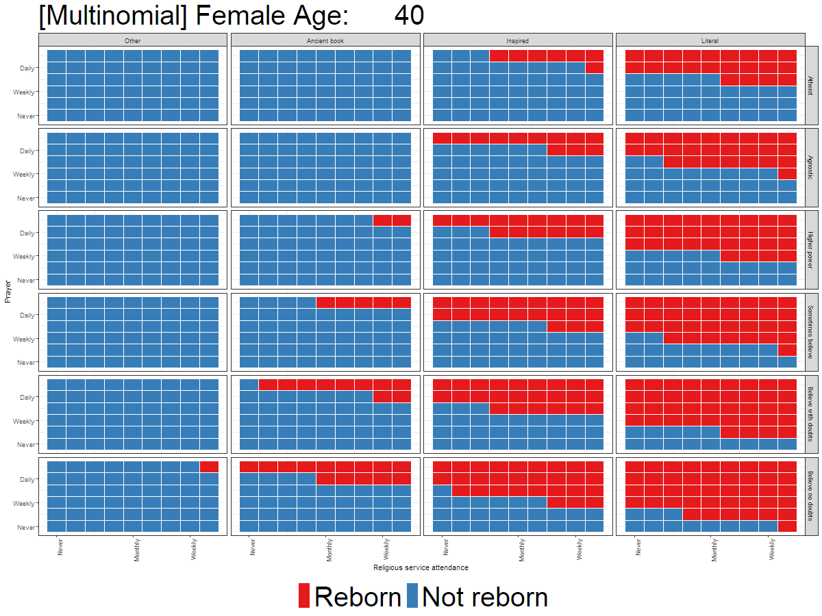
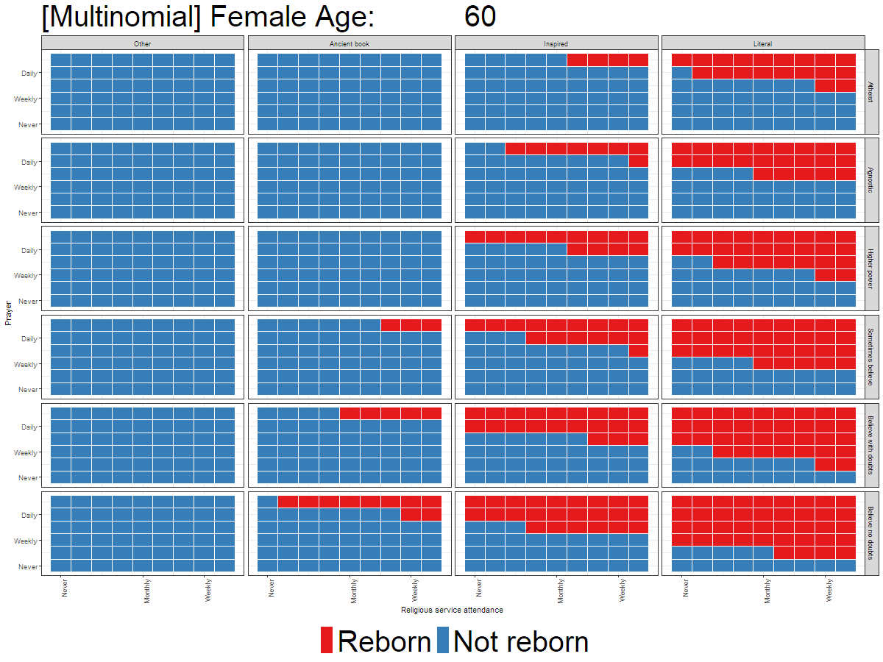
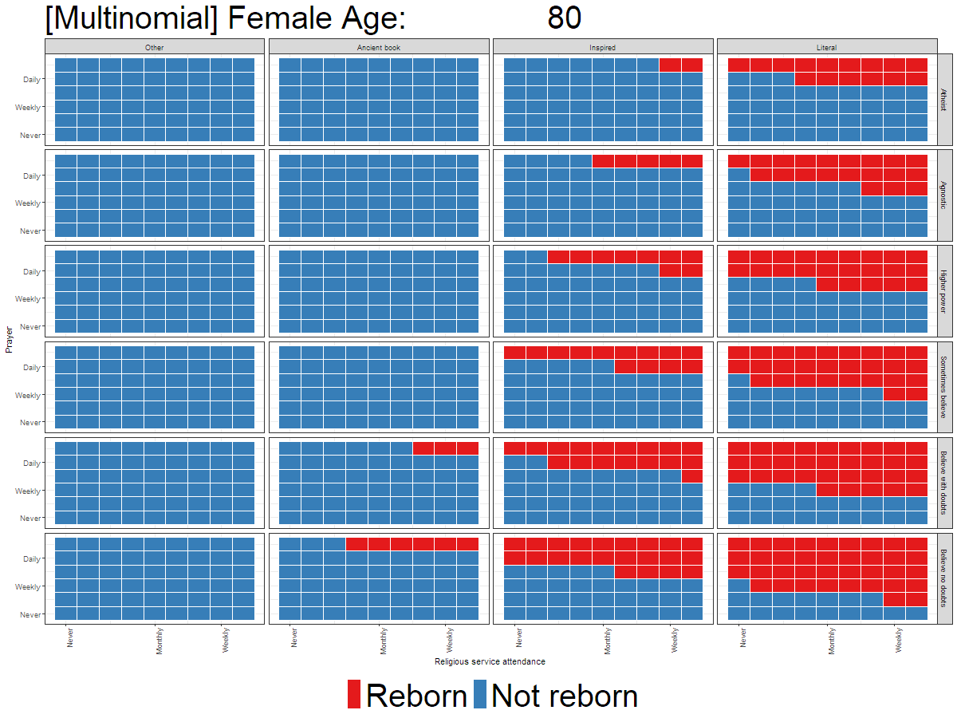

Slide 23
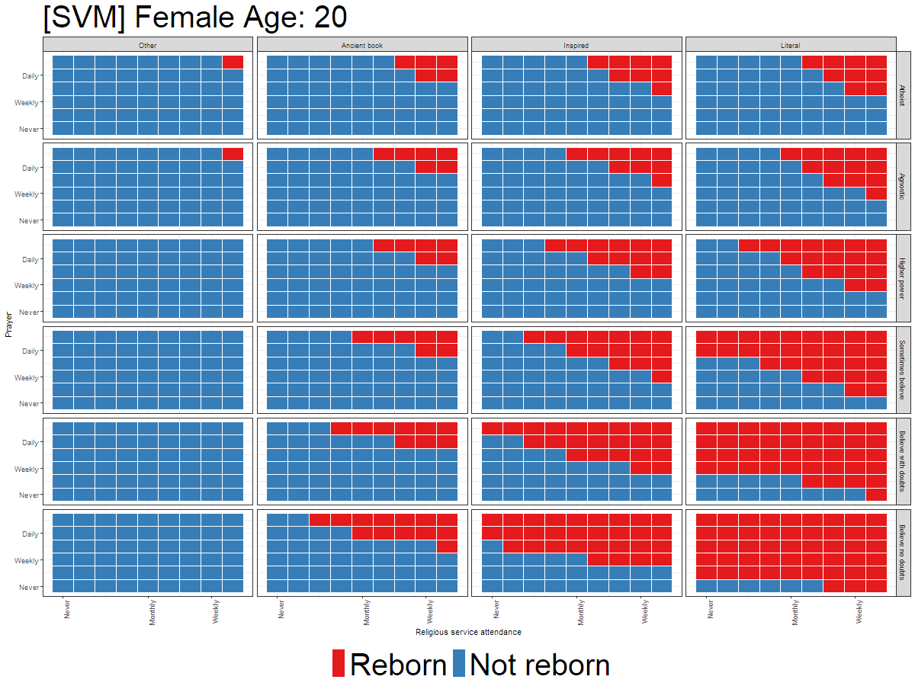
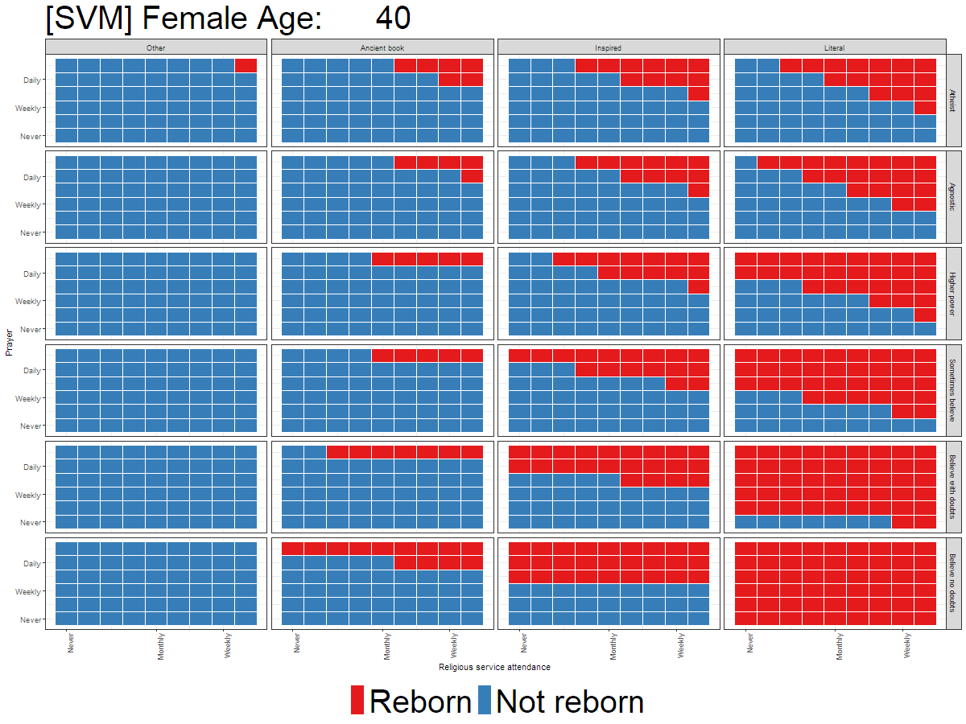
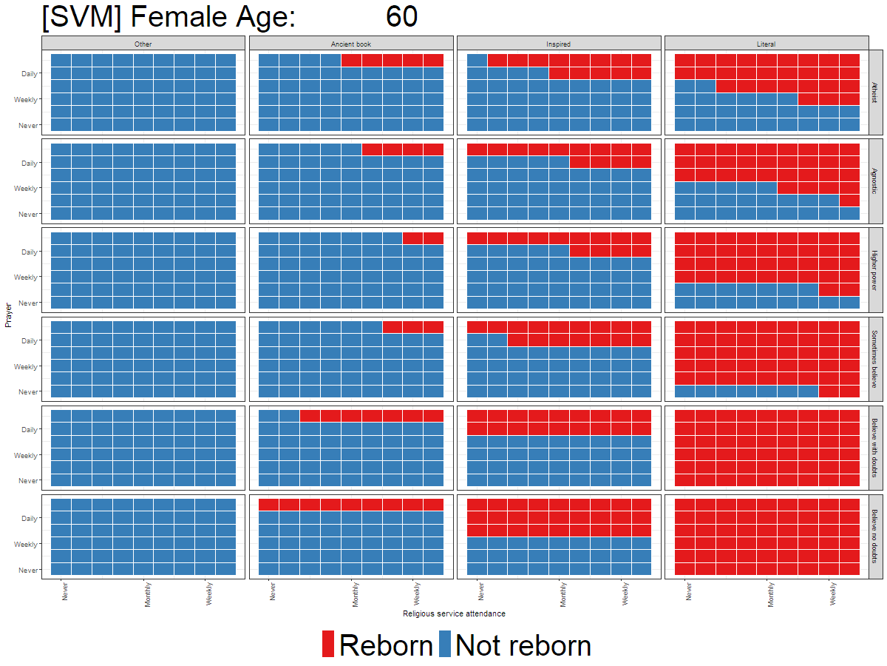
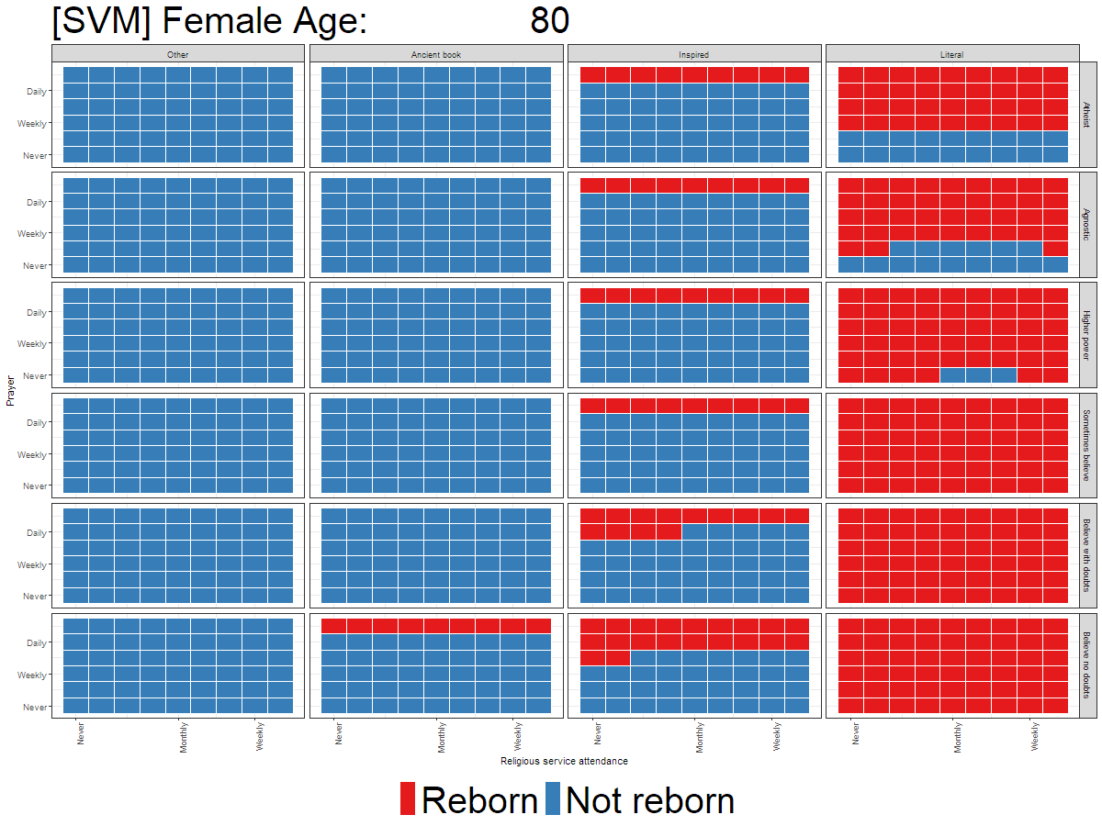

Slide 24
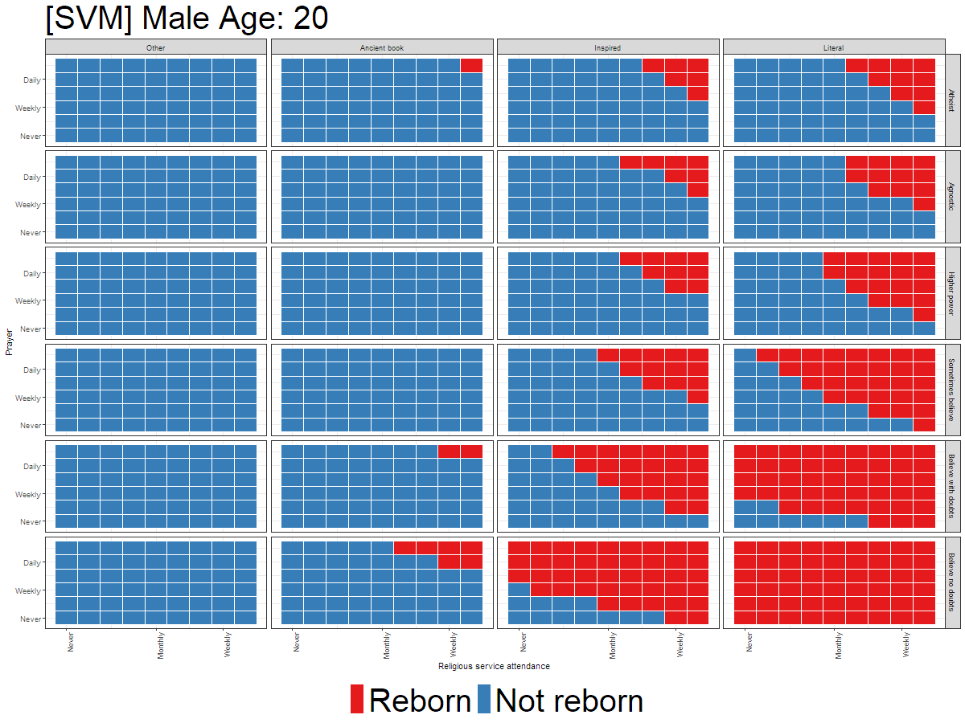
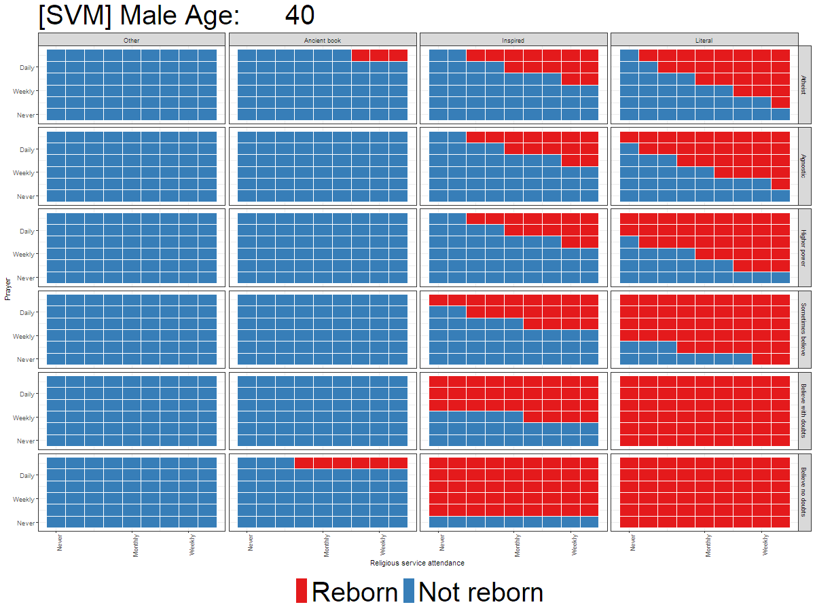
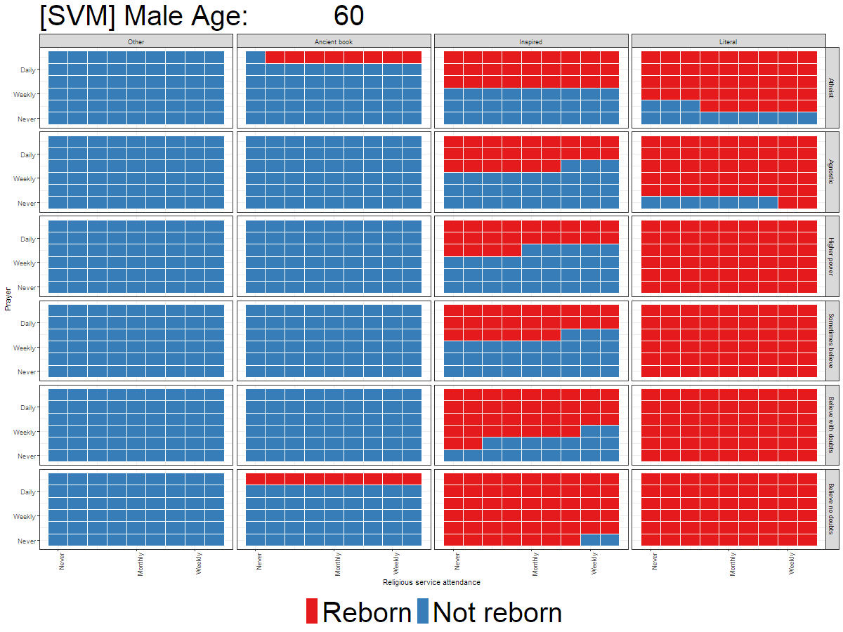
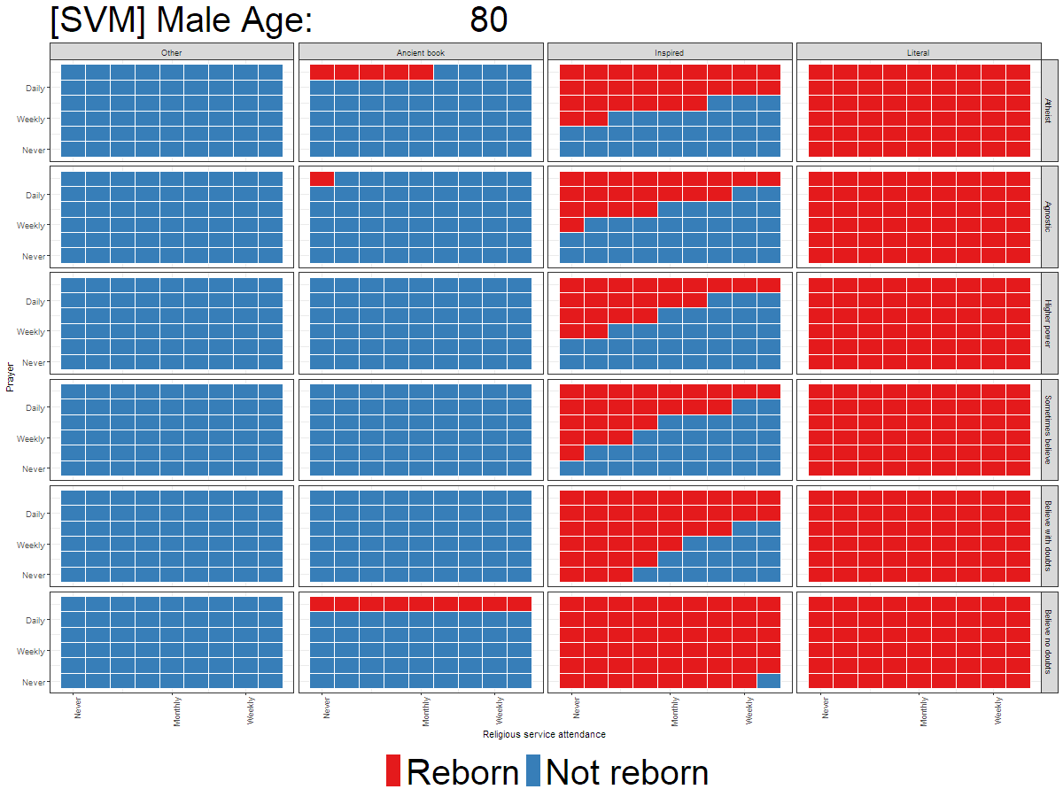

Slide 25
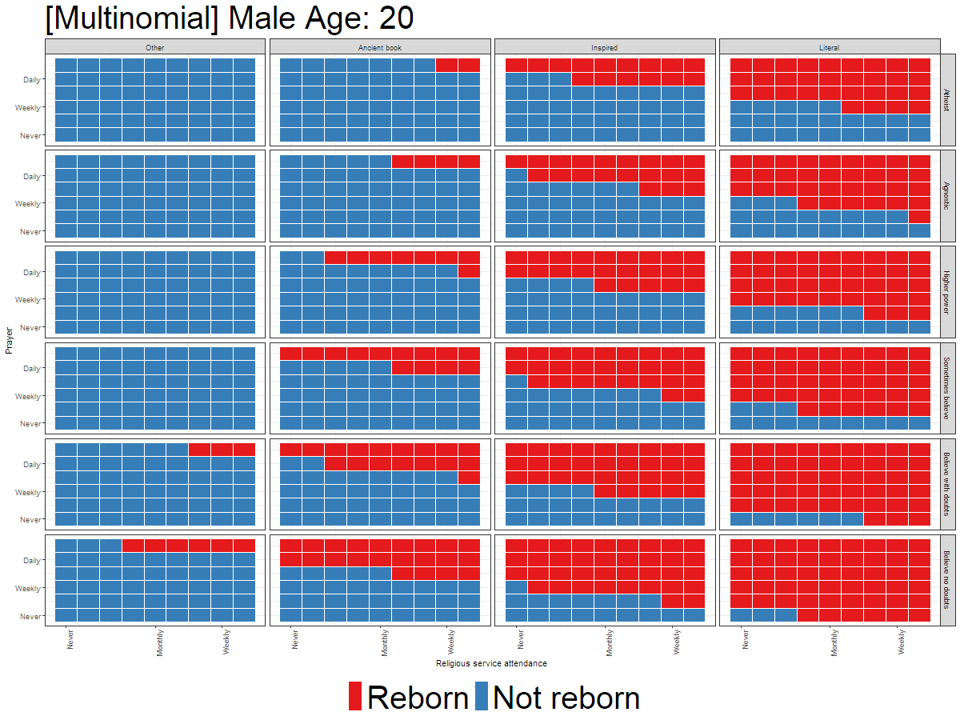

Slide 26
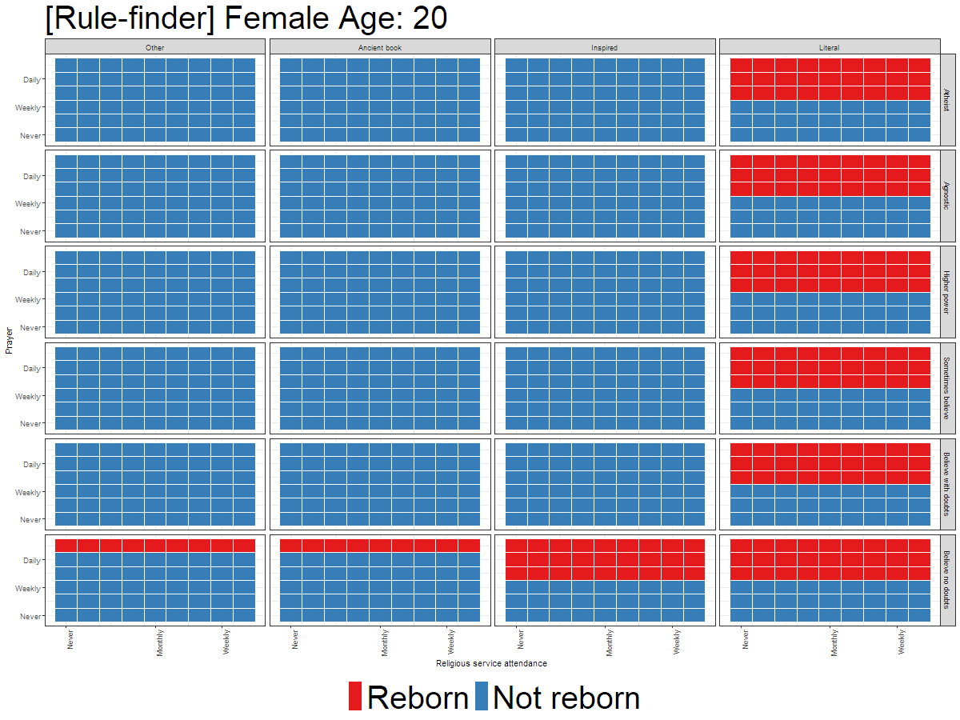
Rule 1: Classify as not Reborn if…
Pray weekly or less often
83% correctly classified

Slide 27
Rule 2: Classify as not Reborn if…
Believe Bible is an ancient book or something else
Have at least some doubts about God
82% correctly classified
Notes:
Rule 1: (1218.5/263.4, lift 1.6)
pray > 2
bible > 1
god > 5
gay_wrong > 0
-> class Reborn [0.783]
Rule 2: (2255.9/834, lift 1.3)
pray > 2
-> class Reborn [0.630]
Rule 3: (883.1/147.6, lift 1.7)
pray <= 2
-> class Not reborn [0.832]
Rule 4: (1080.5/196.8, lift 1.6)
bible <= 2
god <= 5
-> class Not reborn [0.817]
Rule 5: (1635/439.1, lift 1.5)
pray <= 4
bible <= 2
-> class Not reborn [0.731]
Default class: Reborn

Slide 28
Rule 3: Classify as not Reborn if…
Pray daily or less often
Believe the Bible is an ancient book of fables or something else
73% correctly classified
Notes:
Rule 1: (1218.5/263.4, lift 1.6)
pray > 2
bible > 1
god > 5
gay_wrong > 0
-> class Reborn [0.783]
Rule 2: (2255.9/834, lift 1.3)
pray > 2
-> class Reborn [0.630]
Rule 3: (883.1/147.6, lift 1.7)
pray <= 2
-> class Not reborn [0.832]
Rule 4: (1080.5/196.8, lift 1.6)
bible <= 2
god <= 5
-> class Not reborn [0.817]
Rule 5: (1635/439.1, lift 1.5)
pray <= 4
bible <= 2
-> class Not reborn [0.731]
Default class: Reborn

Slide 29
Rule 4: Classify as Reborn if…
Pray several times a week or more often
63% correctly classified (once other rules are taken into account)
Notes:
Rule 1: (1218.5/263.4, lift 1.6)
pray > 2
bible > 1
god > 5
gay_wrong > 0
-> class Reborn [0.783]
Rule 2: (2255.9/834, lift 1.3)
pray > 2
-> class Reborn [0.630]
Rule 3: (883.1/147.6, lift 1.7)
pray <= 2
-> class Not reborn [0.832]
Rule 4: (1080.5/196.8, lift 1.6)
bible <= 2
god <= 5
-> class Not reborn [0.817]
Rule 5: (1635/439.1, lift 1.5)
pray <= 4
bible <= 2
-> class Not reborn [0.731]
Default class: Reborn

Slide 30
Rule 5: Classify as Reborn if…
Pray several times a week or more often
Believe Bible is inspired or literal
Have no doubts about God
Believe that homosexuality is sometimes or less-frequently wrong
78% correctly classified

Slide 31
Substantive take-aways
SVM Model
Belief in the literal interpretation of the Bible is main characteristic distinguishing older female reborn individuals (youngers are fuzzier)
For older men who believe in the inspiration of the Bible, the reborn are found more in those who pray frequently but do not attend religious services as frequently (on their relative scales; more additive for younger men)

Slide 32
Substantive take-aways
Rulefinder
There is variation among those with the identity, but there are significant similarities
We can do a pretty good job predicting someone’s reborn identity using mostly their
frequency of prayer
belief in the Bible’s qualities
It doesn’t take too many rules to do a reasonably good job of predicting reborn identity

Slide 33
Discussion

Slide 34
What did we gain from this?
As-good-as or better performance than traditional methods
Can produce classification rules that are easier to conceptualize than from logistic regression
Easier to avoid spurious causal arguments
Focus on prediction highlights the extent of success and failure of a model

Slide 35
What do we need to be conscious of?
We are presented with different challenges than those faced by other practitioners of these methods
Complexity has an interpretive price (performance-intuitive tradeoff)
Must determine substantively meaningful thresholds for what is “good” (or “good enough”) prediction
Visualization can be painful

Slide 36
Thank you
Simon Brauer, Ph.D.
simon.brauer@duke.edu
www.simonbrauer.us

Slide 38
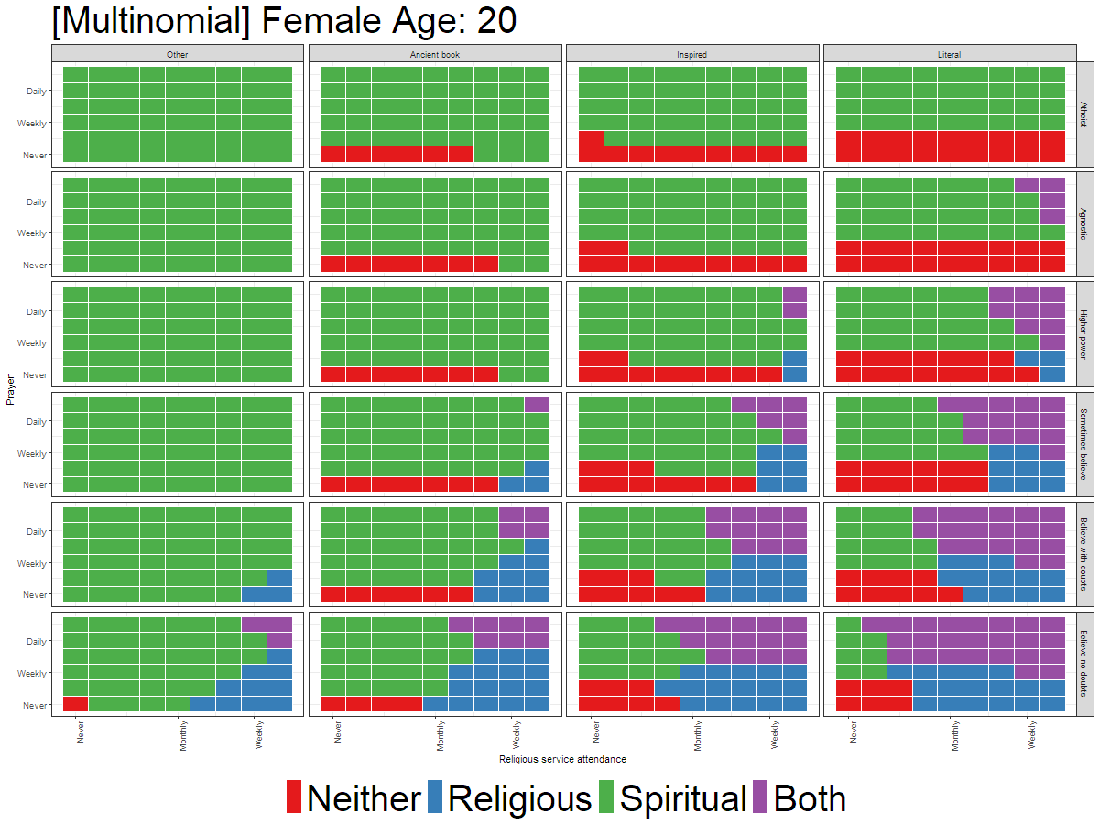

Slide 39
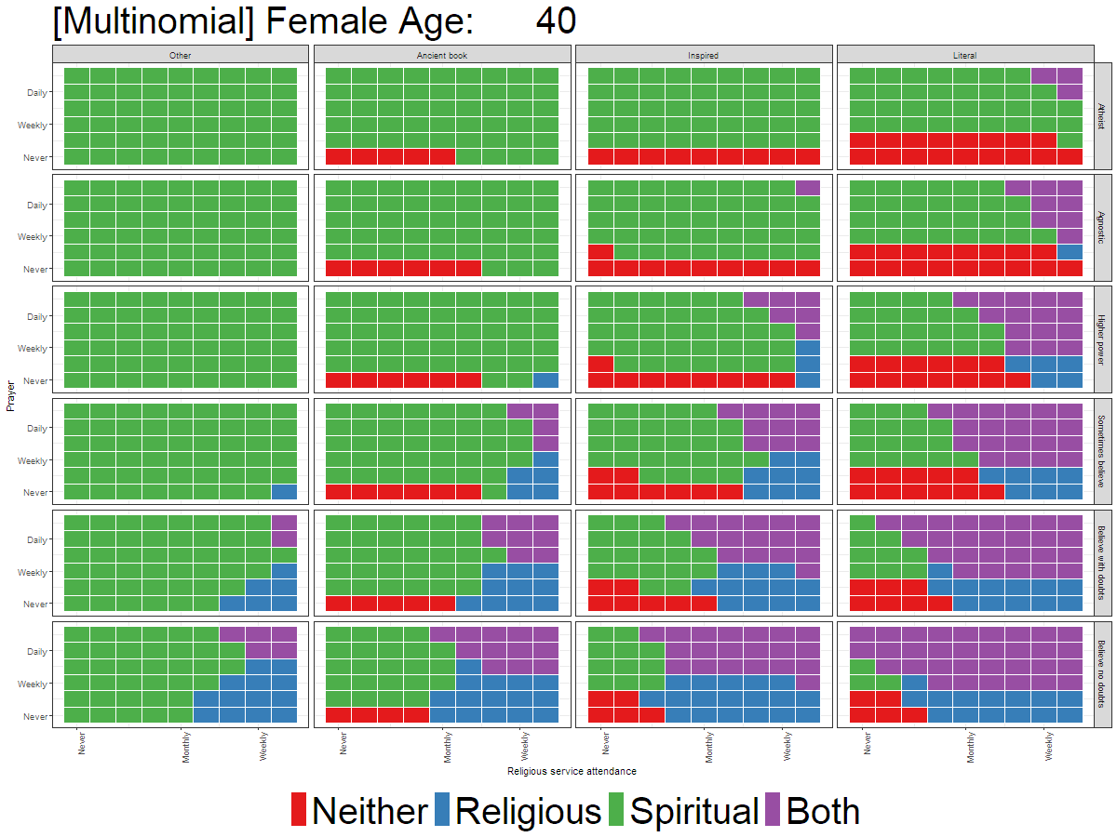

Slide 40
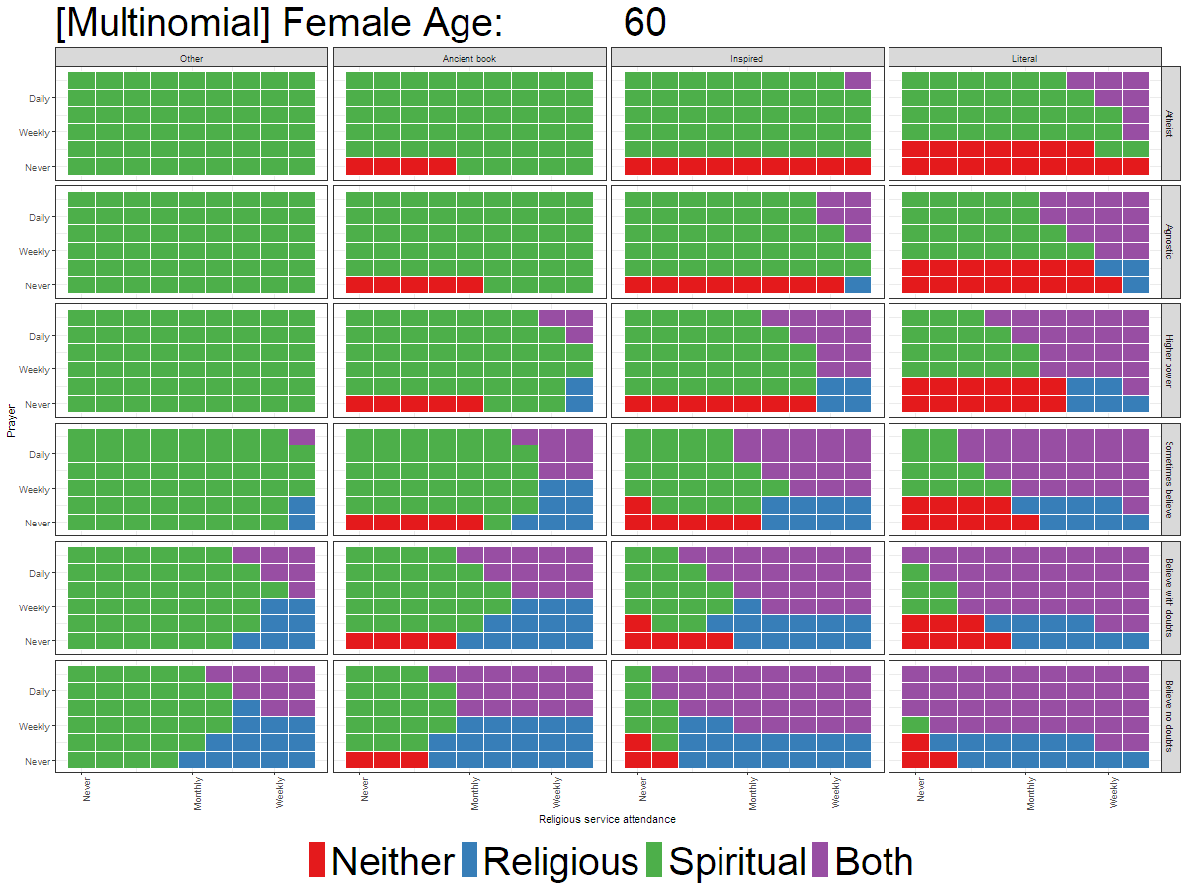

Slide 41
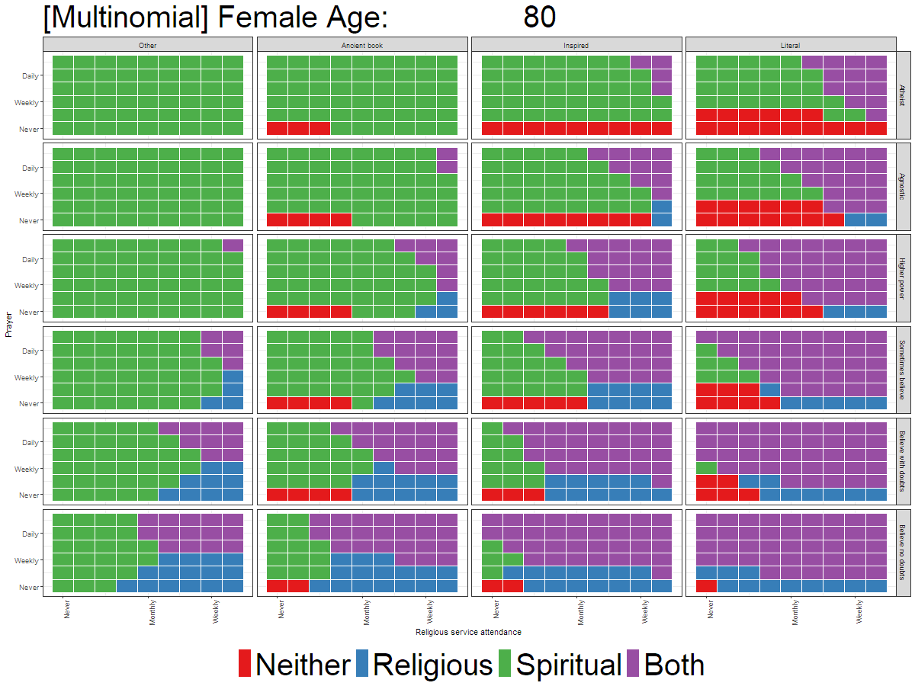

Slide 42
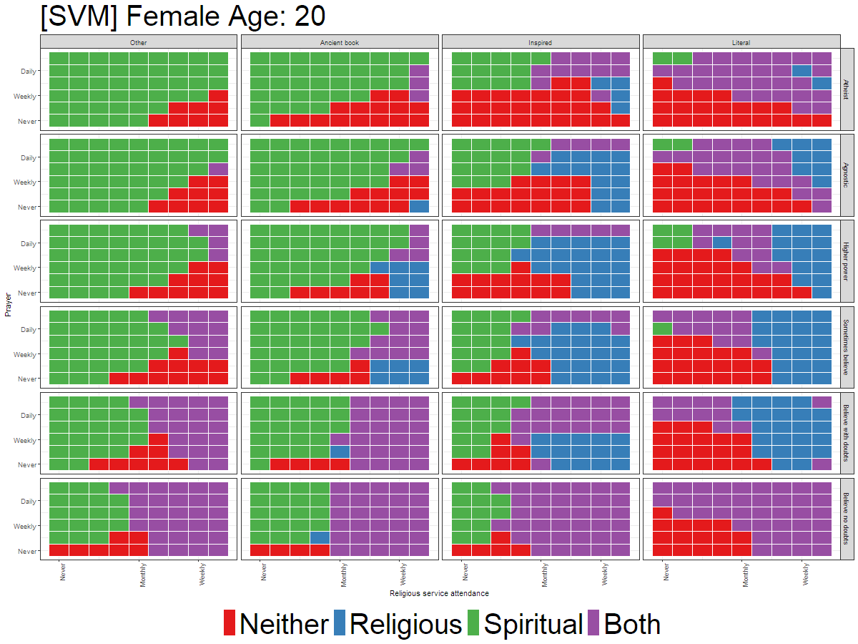

Slide 43
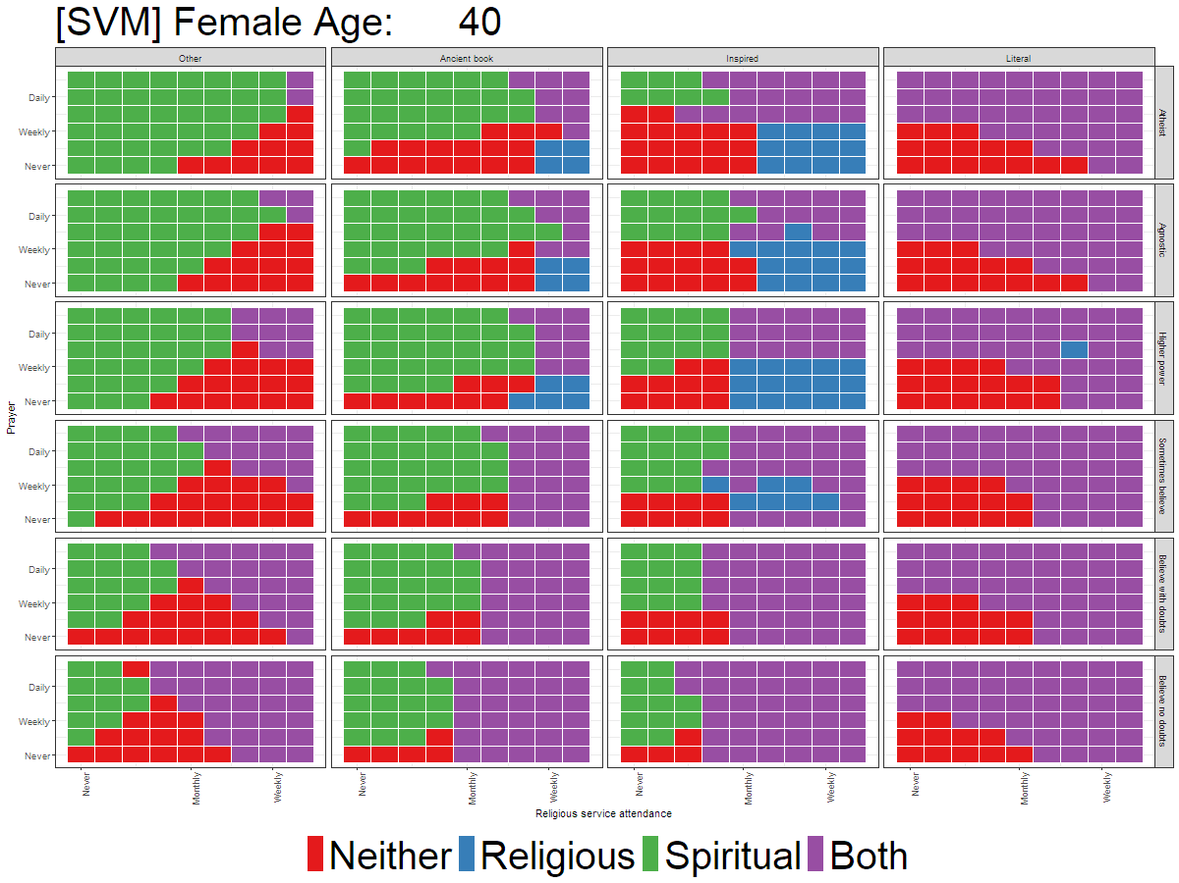

Slide 44
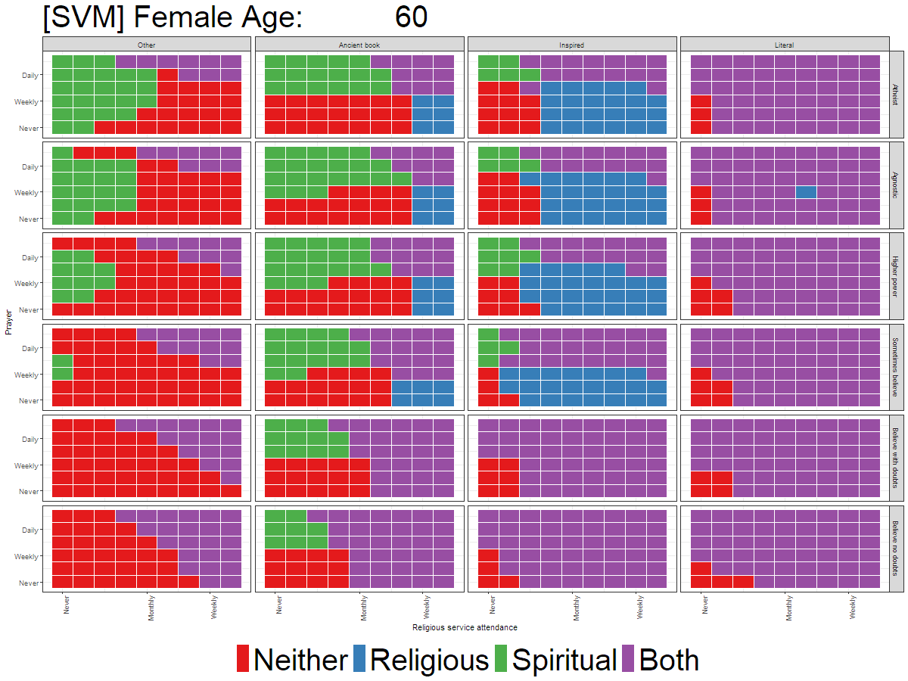

Slide 45
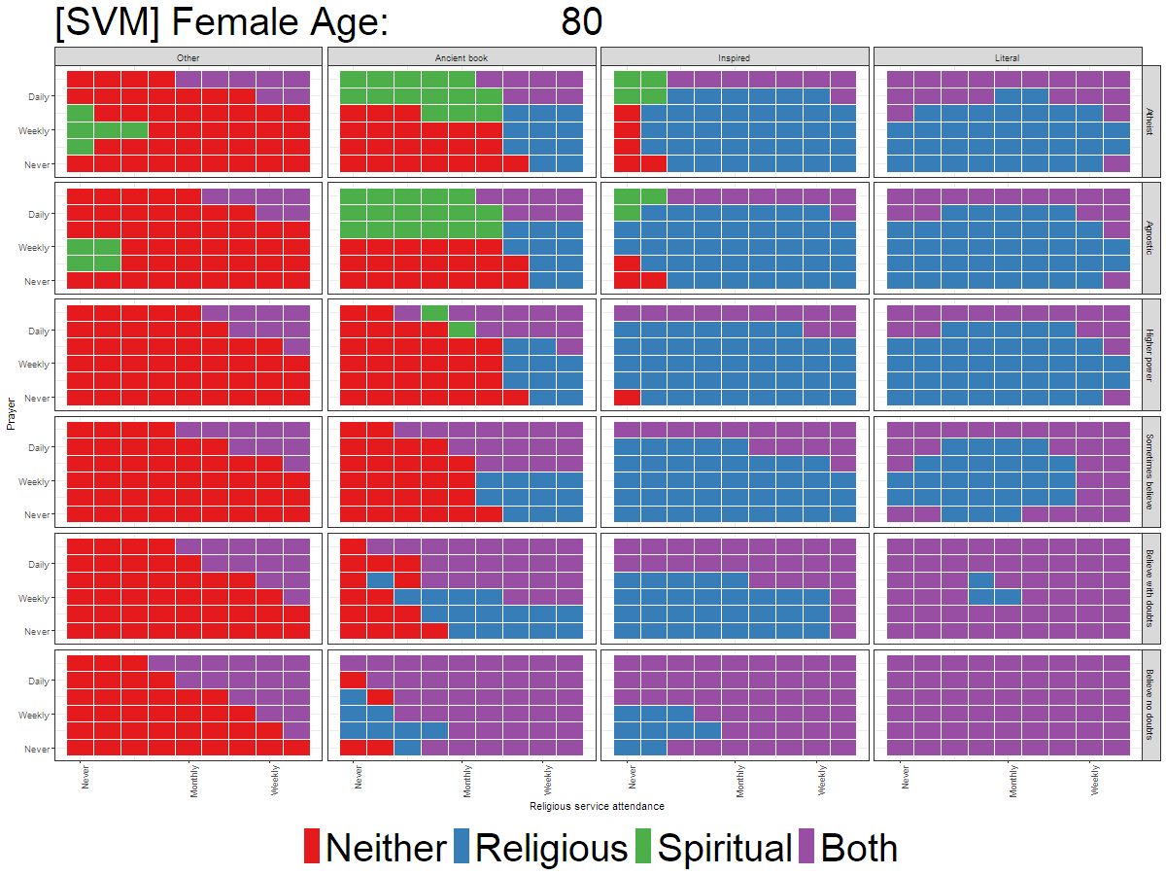

Slide 46
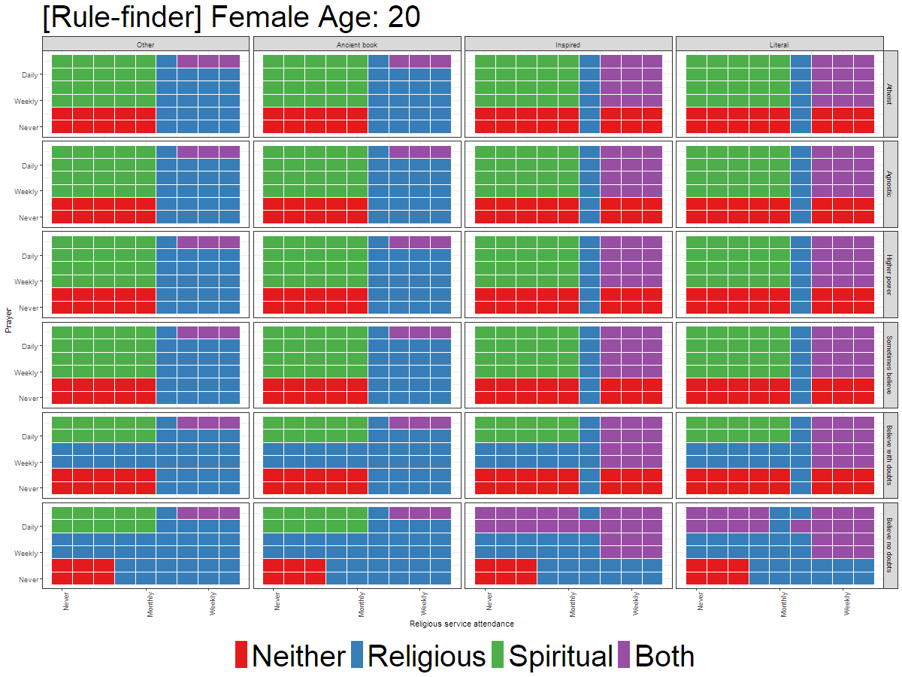

Slide 47
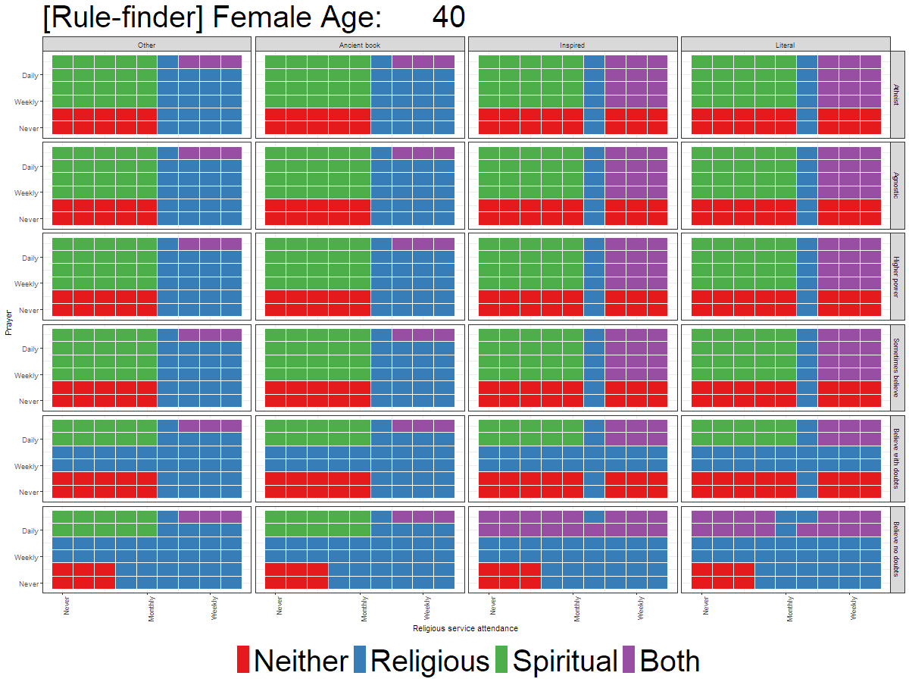

Slide 48
